Slide 1
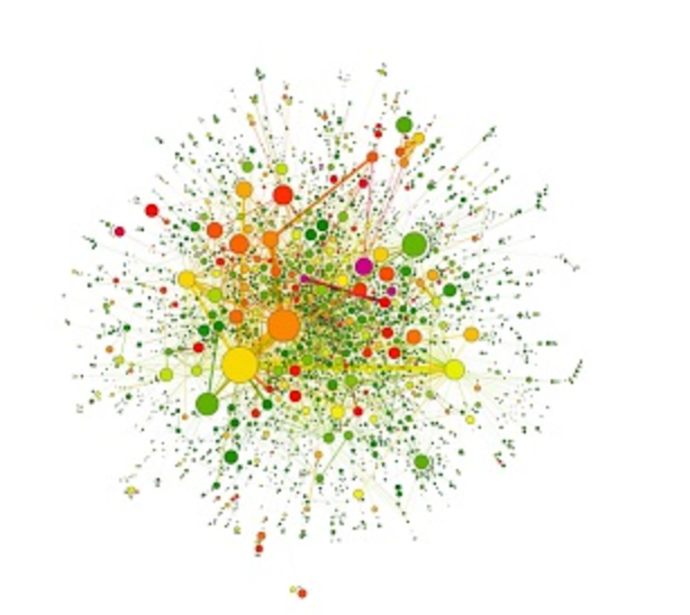
P(egs) bioinformatics for Postgrads
Postgraduate Evolution and Genomic Science Lecture series.
Notes:
----- Meeting Notes (03/06/19 13:46) -----

Slide 2
Hi! I’m Alex!
Alexandra Martin-Geary, 4th year PhD student
Evolutionary bioinformatics of human disease
~Robertson Lab
(Heritable disease, Viruses, Parasites, Molecular evolution)
@Alextremophile

Slide 3
P(egs) lectures
Six Lectures
Every other Monday, 1pm
Graphics using R Today!
Protein structure analysis 17th/6th
Phylogenetics 1st/7th
Networks 15th/7th
Machine learning & 29th/7th
Single cell analysis
Version control 12th/8th

Slide 4
Introduction to R
Introduction to programming languages R and Python and their use in basic bioinformatics (in particular the rise of the GUI!)
Notes:
R is a programming language, but don’t let that put you off!
You don’t need to be a coding wizard in order to get great images, you just need to understand the basics!

Slide 5
Introduction to R
Datatypes – character, numeric, integer, complex and logical
Data Structures –
1. Atomic vector: 1 item of any type
2. List: a list of items of different types
3. Table: Can have different data types
4. Matrix: 2D, same data types
5. Array: 3+D, same data types
Notes:
Different ‘types’ of data are called specific things. It is important to know what types of data you are dealing with, as the program will interpret and use them in different ways.
Characters are words, or ‘strings’ of characters, such as ‘Alex’ or ‘Alex Samira and Jo’.
Numeric data is data made up of whole numbers such as ‘1’ or ‘897’.
Integers are numbers with decimals such as ‘1.8’ or ‘897.4357689’.
Complex numbers involve algebraic notation/symbols such as ‘1+2i”.
Logical data is the result of a comparison between two values and will result in an output of TRUE or FALSE, for example 2=2 is ‘TRUE’.
You can find more about it in this useful tutorial: http://www.r-tutor.com/r-introduction/basic-data-types
Data structures are the way in which your data is stored. I like to imagine them as shapes.
An atomic vector is a single value that you have stored. For instance, if I were to want to store the number four, I could create an object ‘FOUR’ and store the number 4 in it. When I ask R what ‘FOUR’ is, it will tell me that it is an atomic vector, of numeric type. Atomic vectors can be any type you like as they only contain only one thing.
A list is exactly that – a list of items. Lists are very like a column you might see in excel. Each of the cells can have a value of the same, or different type in it. E.G. 1,2,3,4,5,6 would be a list of numeric type.
A table is a selection of data which has one or more rows and columns. Each value within a column must be the same type, but different columns can have different types. For example, if I have some data representing flowers, it might have the following columns: Flower name, Number of petals, and length of stem, each of which would be a different type of data.
A matrix is very like a table, only all the data within it has to have the same type. These types of structure are incredibly useful when you are doing statistics as often you will need to have a set of numeric data wherein the values can each be compared with the other.
Finally an Array is a set of data with 3 or more dimensions where all of the data is of the same type. These are complicated data structures that can be used for more complicated multi-dimensional plotting such as networks.

Slide 6
Introduction to R
3) What is R/R studio
How is it not excel?
R, Huh, good god y’all - What is it good for? (Stats and Graphics)
Notes:
R is a lot more versatile and reliable than excel. When you are dealing with very large data excel can struggle, loose rows or simply not load the whole set. R however is able to take in all of your data, and thanks to the ability to download and use other people’s code as packages, you can make a much larger number of beautiful plots, simply by mixing your data with their code!

Slide 7
Introduction to R
4)Stats
Name.of.test(data)
Notes:
In general, the majority of stats you can do in R are incredibly simple. Once you know what sort of data the stats test needs (for example a list of numeric values) the majority of tests simply need you to type the name of the test, then the name of your data in brackets, for example if I had a set of numbers (1, 2, 3, 4, 5, 6) called alex.data I could find out the mean by typing- mean(alex.data).

Slide 8
Introduction to R
5)Graphics
Bar, line, scatter, bubble, violin, heatmap, trees, pca, network, sankey, maps, timeseries,
https://www.r-graph-gallery.com
Notes:
There are lots of awesome things you can do in R, so many in fact that it can be difficult to choose the best plot type for your data (especially if you don’t know what plots are available to make!)
In the next slides you will see just a few of the possibilities, but there are a lot more! (see www.r-graph-gallery.com for reference)

Slide 9
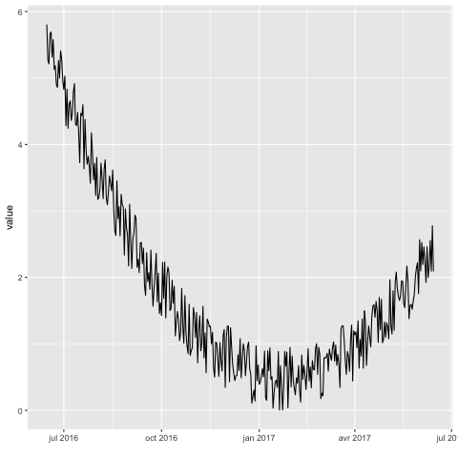
Time Series
https://www.r-graph-gallery.com
Notes:
Obviously pretty useful for time series data!

Slide 10
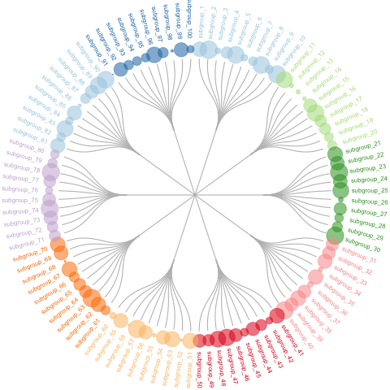
Dendrograms
https://www.r-graph-gallery.com
Notes:
Dendrograms can be used to visualise relationships to an ancestor, and hierarchies amongst other things – they are terribly pretty!

Slide 11
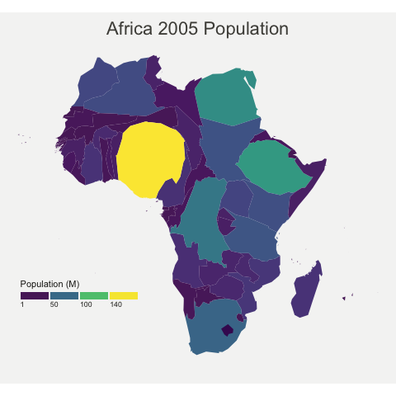
Cartography
https://www.r-graph-gallery.com
Notes:
Cartography can help you map hotspots, spread, and density amongst others.

Slide 12
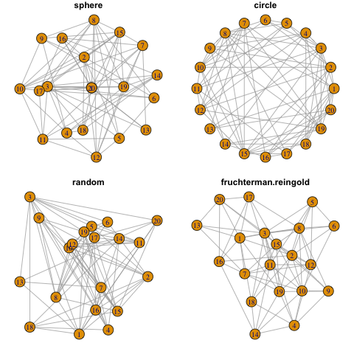
Networks
https://www.r-graph-gallery.com
Notes:
Networks are an excellent way of visualising relationships and information flow.

Slide 13

ART
https://www.r-graph-gallery.com
Notes:
Or you could just make beautiful art!

Slide 14
What we will be looking at today:
Topic 1 – Basic Data analysis (Counts, averages, basic stats)
Topic 2 – Simple Graphics (Bars, scatters and lines)
Topic 3 – More complexity (Cluster Plots, PCA, NetworkD3)
Notes:
These are the basic topics we will be covering in the first part of this lecture.

Slide 15
The Iris dataset (Get used to it – you will see it a LOT!)
>iris
Sepal.Length Sepal.Width Petal.Length Petal.Width Species
1 5.1 3.5 1.4 0.2 setosa
2 4.9 3.0 1.4 0.2 setosa
3 4.7 3.2 1.3 0.2 setosa
4 4.6 3.1 1.5 0.2 setosa
5 5.0 3.6 1.4 0.2 setosa
Notes:
This is the iris dataset. It is on of the example datasets that is built in to R. You can see it by typing ‘iris’. The greater than symbol is what R puts at the beginning of every line to show that it is ready to receive a new command. If the > symbol isn’t at the start of your line when you want to type in a new command, it probably means that the program is still busy working on the previous command you gave it.

Slide 16
The Iris dataset (Get used to it – you will see it a LOT!)
>iris
Sepal.Length Sepal.Width Petal.Length Petal.Width Species
1 5.1 3.5 1.4 0.2 setosa
2 4.9 3.0 1.4 0.2 setosa
3 4.7 3.2 1.3 0.2 setosa
4 4.6 3.1 1.5 0.2 setosa
5 5.0 3.6 1.4 0.2 setosa
Notes:
The numbers on the left hand side aren’t actually in the data – they are an addition from R to help you refer to each row. This is useful because sometimes you will want to take a subset of data by choosing only rows 2,3 and 4 for example.

Slide 17
The Iris dataset (Get used to it – you will see it a LOT!)
>iris
Sepal.Length Sepal.Width Petal.Length Petal.Width Species
1 5.1 3.5 1.4 0.2 setosa
2 4.9 3.0 1.4 0.2 setosa
3 4.7 3.2 1.3 0.2 setosa
4 4.6 3.1 1.5 0.2 setosa
5 5.0 3.6 1.4 0.2 setosa
Notes:
These are your column names. In the iris dataset R already knows that these names aren’t supposed to be included in the main data, instead they are a useful way to say which column you are looking at, for example if I wanted to know the mean sepal width I could type mean(iris$Sepal.Width) – this way the program knows I want the mean of ‘iris’ data, column ‘Sepal.Width’.
If R didn’t recognise Sepal.Width as the title of the column it wouldn’t be able to calculate mean as it would try to include ‘Sepal.With’ in the calculation… which wouldn’t work as its not a number! When you are loading in your own data you need, therefore, to let it know if your columns have titles or not (I will show you how later).

Slide 18
The Iris dataset (Get used to it – you will see it a LOT!)
>iris
Sepal.Length Sepal.Width Petal.Length Petal.Width Species
1 5.1 3.5 1.4 0.2 setosa
2 4.9 3.0 1.4 0.2 setosa
3 4.7 3.2 1.3 0.2 setosa
4 4.6 3.1 1.5 0.2 setosa
5 5.0 3.6 1.4 0.2 setosa
Notes:
This is the main data that will actually get used when you ask R to do things.

Slide 19
Types of R user software
Base R: No frills coding environment
R-Studio: Much more user friendly (Will demo in today’s lecture)
Plotly (https://plot.ly/create/#/)
Notes:
Base R is the no-frills programming language, in this there is only one viewing window, you can only see your data if you call it up, and any plots you make open in a popup. It is very much no nonsense, but is also more difficult for the average beginner to use.
R-studio is a lot more user friendly (it needs base R to have been installed on your computer in order to run). It has lots of buttons and options and mini windows, and is a lot more akin to excel in its user-friendliness!
Plotly is an online tool developed by a Canadian company. It is very user friendly, however, and plots you make are publicly available for anyone to look at. Obviously this isn’t ideal if you are doing sensitive research. This isnt the end of the world however – once you are used to the types of data and their shapes you can make ‘toy’ versions of your data to use in plotly. Using ‘toy’ or face data you can make the type of plot you want, then copy the R-code plotly makes and paste it into R-studio, putting the real data in place of the ‘toy’ data you used in plotly. This way you get a lot of the useablity, with greater security.

Slide 20
R-Studio
R studio
Autofill! (super helpful!)
Viewing windows (Base R doesn’t have this)
Lots of buttons!! (More buttons than Sharpe!)
Notes:
These are just some of the reasons to love R-studio!

Slide 21
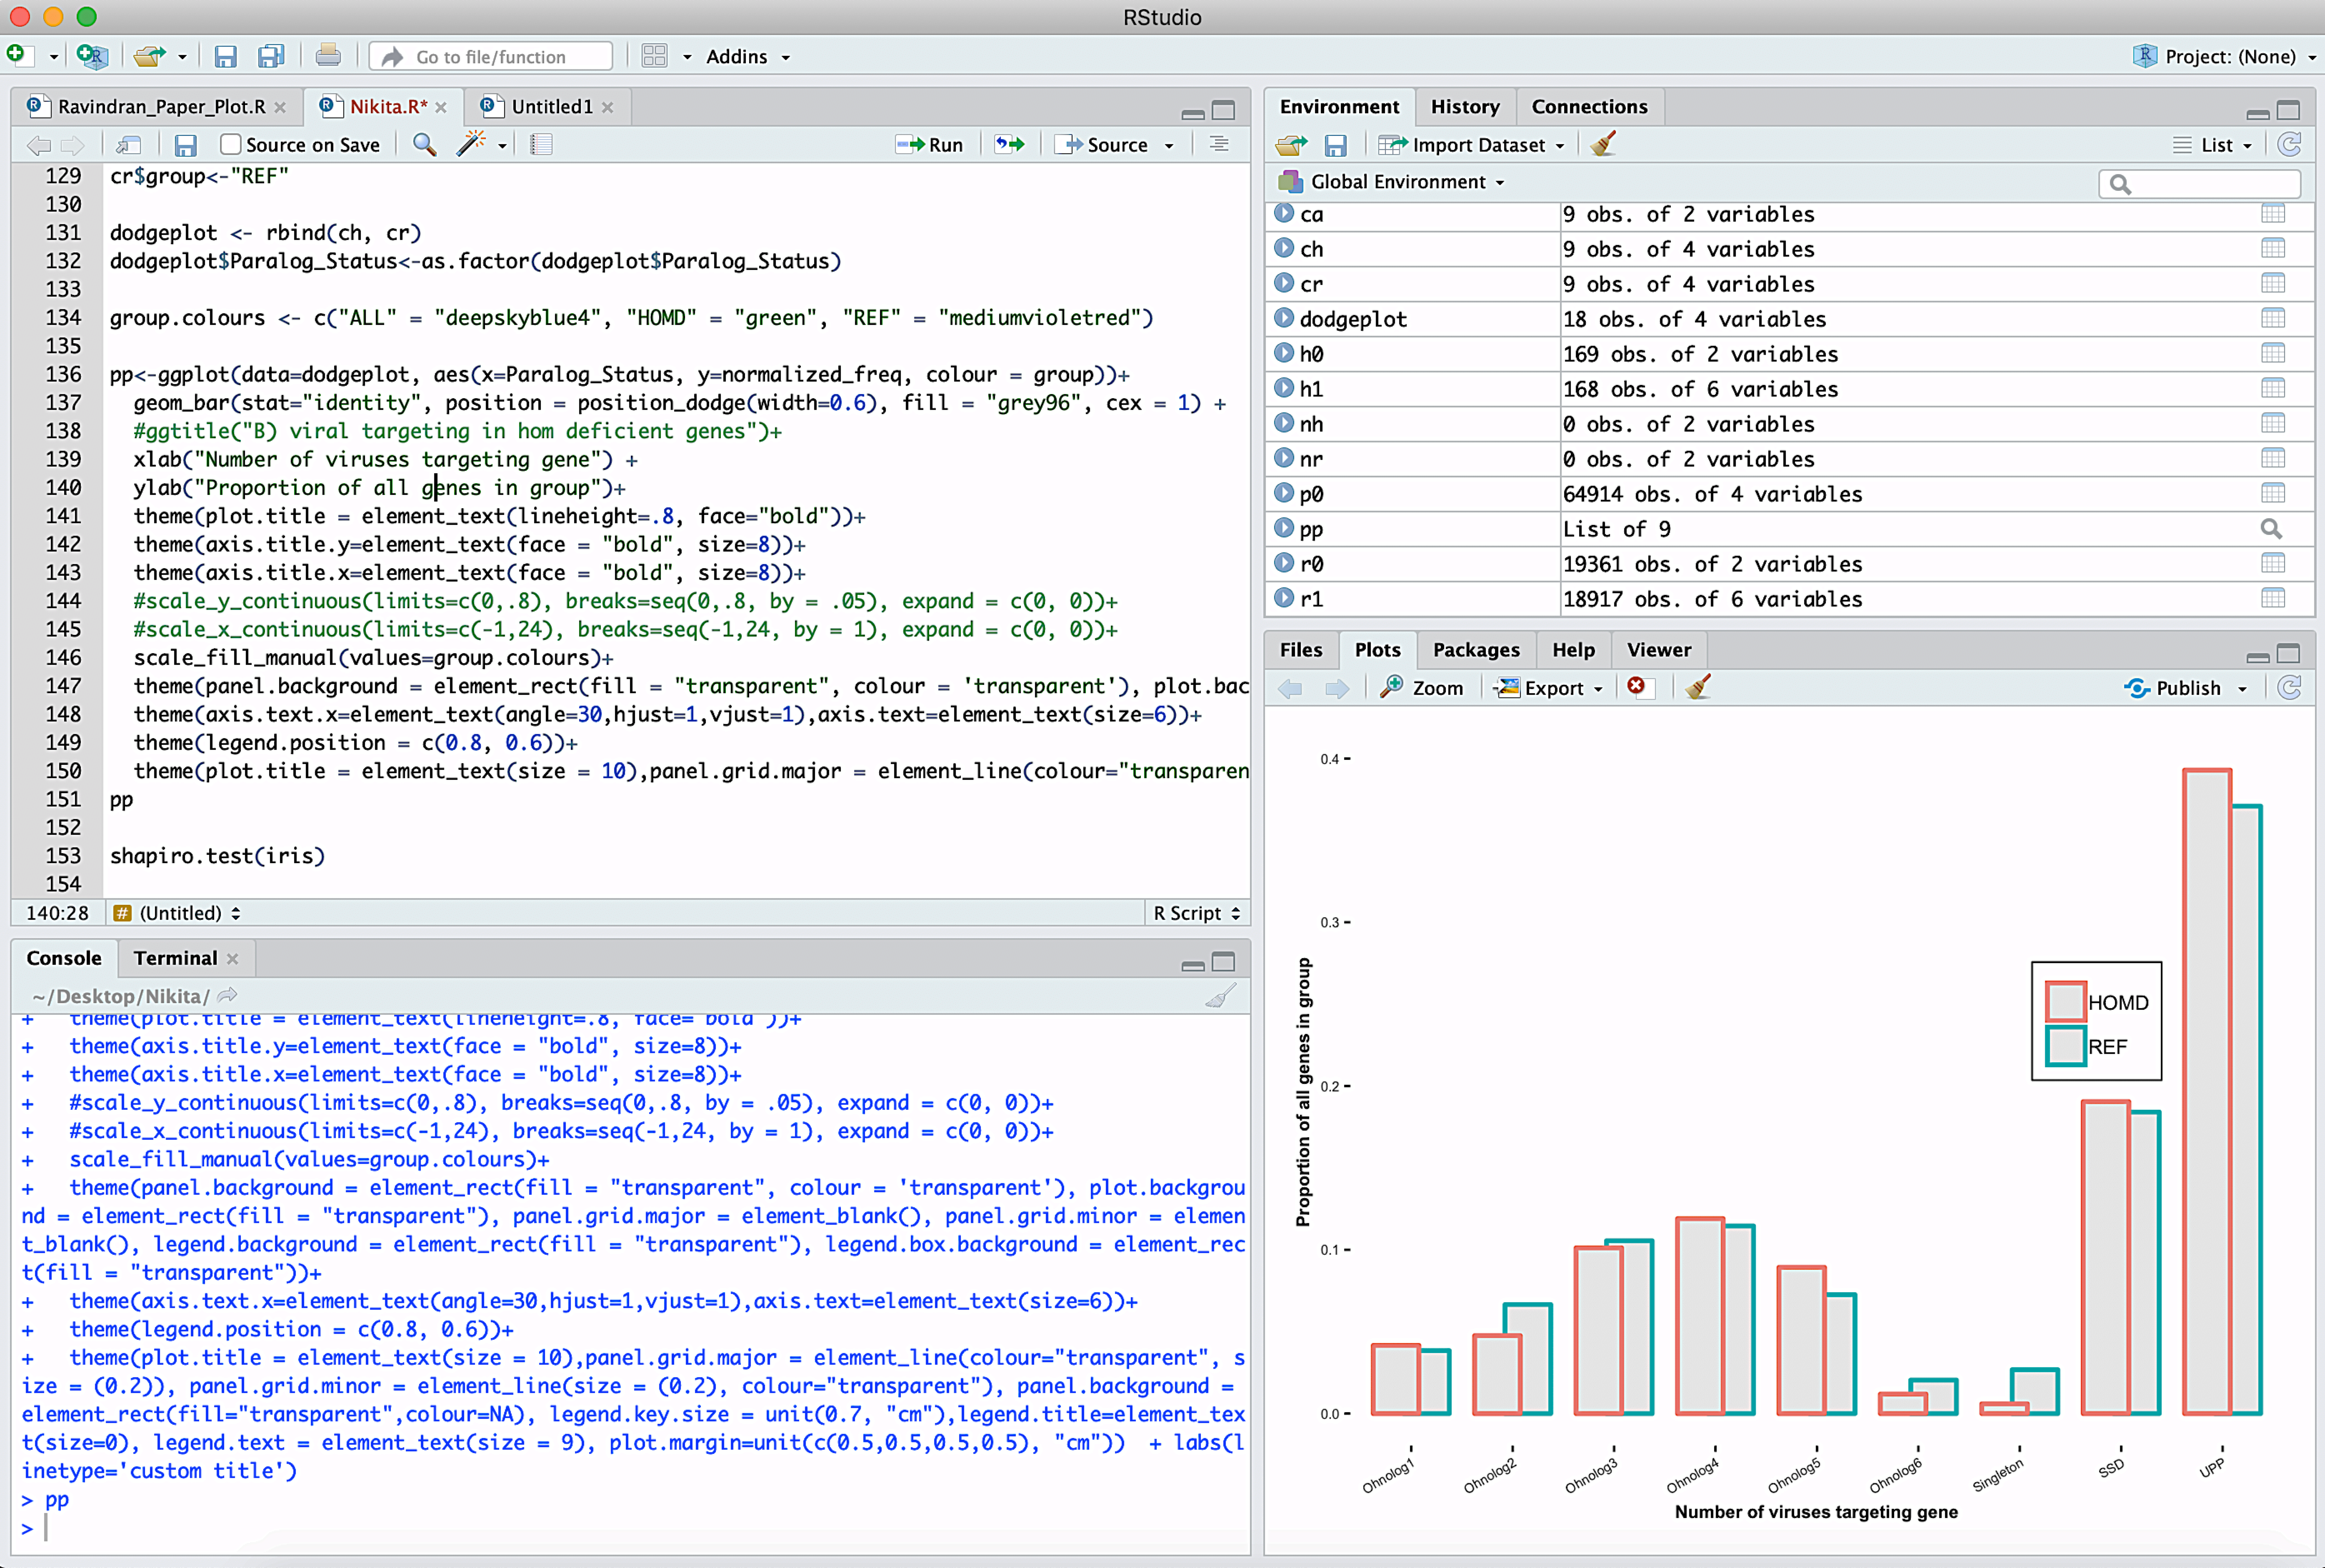
R studio
Notes:
This is a text editing window. You can use it to write and save your code (sort of like a word file) before you run it.

Slide 22
R studio
Notes:
This is the running window and the the ‘run’ button. When you are done writing your code you can highlight the bit you want to run in the text editing window and hit this button – your code will appear in blue in the bottom window when it has run. You could also copy paste your code into the bottom window and hit return, or type it in to this window manually – but the easiest option is to just highlight it and hit run!

Slide 23
R studio
Notes:
This window shows you all of the data you have uploaded, what type of data and structure it is, and what you have called it. (this is really useful for keeping track of things). You can also look at your data by clicking on it, or using the tabs at the top.

Slide 24
R studio
Notes:
This is where your plots appear! You can scroll through them by clicking the forwards and back buttons.

Slide 25
Loading in data and packages
A package is like an update, but you choose to install it rather than it being forced on you!
Sometimes packages mask each other, so watch out for warnings
Everyone’s R is unique, like a fingerprint!
Loading files: knowing where to look
Loading files: Understanding file-types
Storing things in ‘variables’
Notes:
Packages are code that has been written by members of the R community that do different jobs. They are super useful because they have done the hard work so you don’t have to. Once you have downloaded the package you want you just have to load it in, then R will know how to do whatever it is that package was built to do. Remember – you only have to download it once, but you will need to load it in every time you want to use it.
To download the package ggplot2 (the best graphics package) you would write:
install.packages(“ggplot2”)

Slide 26
Loading in data and packages
rm(list= ls())
library(tidyverse)
library(plyr)
#Load data
setwd("/Users/alex/Desktop/")
v0 <- read.csv("Alex_sheet_analysis.csv", header = T) [c(13)]#Path to Data
Notes:
This is a basic set of code that loads in the packages tidyverse and plyr (both very useful), then gets a file of my data that I have saved on the desktop of my computer.

Slide 27
Loading in data and packages
rm(list= ls())
library(tidyverse)
library(plyr)
#Load data
setwd("/Users/alex/Desktop/")
v0 <- read.csv("Alex_sheet_analysis.csv", header = T) [c(13)]#Path to Data
Get rid of any residual data from last session
Notes:
This is super important- R remembers what you did in your last session. If you want to start from a clean slate you have to wipe the recent memory in R, this stops any previously loaded packages or data interfering with the analysis you want to run now.

Slide 28
Loading in data and packages
rm(list= ls())
library(tidyverse)
library(plyr)
#Load data
setwd("/Users/alex/Desktop/")
v0 <- read.csv("Alex_sheet_analysis.csv", header = T) [c(13)]#Path to Data
Tell it which packages to install
Notes:
Once you have cleared the memory, you need to load the packages you want to use from your library of downloaded packages – this is how!

Slide 29
Loading in data and packages
rm(list= ls())
library(tidyverse)
library(plyr)
#Load data
setwd("/Users/alex/Desktop/")
v0 <- read.csv("Alex_sheet_analysis.csv", header = T) [c(13)]#Path to Data
Tell it which folder you want to use for your analysis
Notes:
Setwd means set working directory – this tells R that the place in my computer that I want to use is my desktop. Once I have told it this, R will look in this location for the data I want to load, and will save any any output to this location too.
If I wanted to look in a folder called “R_stuff” on my desktop instead, I could type
setwd(“/Users/alex/Desktop/R_stuff/”)

Slide 30
Loading in data and packages
rm(list= ls())
library(tidyverse)
library(plyr)
#Load data
setwd("/Users/alex/Desktop/")
v0 <- read.csv("Alex_sheet_analysis.csv", header = T) [c(13)]#Path to Data
Name the container that your data will be stored in
Notes:
Here we are telling R that we want to create a storage container in which to keep our information called v0. The arrow pointing at v0 indicates that whatever follows will be put into the new container.

Slide 31
Loading in data and packages
rm(list= ls())
library(tidyverse)
library(plyr)
#Load data
setwd("/Users/alex/Desktop/")
v0 <- read.csv("Alex_sheet_analysis.csv", header = T) [c(13)]#Path to Data
Choosing the right file
Notes:
Here we are telling it the name of the file we want to import. If you haven’t set the working directory (you don’t have to) then you would need to tell it the full location of the file here (e.g. “/Users/alex/Desktop/Alex_sheet_analysis.csv”). One of the reasons I like the setwd command is that it means you don’t have to repeatedly type out the whole location of thing s if you want to load/save multiple files that are all in the same place.

Slide 32
Loading in data and packages
rm(list= ls())
library(tidyverse)
library(plyr)
#Load data
setwd("/Users/alex/Desktop/")
v0 <- read.csv("Alex_sheet_analysis.csv", header = T) [c(13)]#Path to Data
Telling it how to read the file (what format)
Notes:
The characters after the dot in your file name are very important as they tell R what sort of file you are giving it, and how it should be read. There are many different types of file, here are a few:
.csv = comma separated values (each value is separated by a comma)
.txt = a text file, the values are generally separated by either spaces or tabs – you should always try and avoid having spaces within your values as it can lead to R thinking it is a separator when reading it in, the best way is to make your values contain underscores rather than spaces.
.tab = a tab separated file.
As you can see, here we are telling it that this is a comma separated value file, we have also said this at the beginning of the line by telling it to read a csv (read.csv())

Slide 33
Loading in data and packages
rm(list= ls())
library(tidyverse)
library(plyr)
#Load data
setwd("/Users/alex/Desktop/")
v0 <- read.csv("Alex_sheet_analysis.csv", header = T) [c(13)]#Path to Data
Giving it a bit more info
Notes:
When we talked bout letting R know if your column has names this is what I meant. Here I am saying that headers equals true (my data does have column titles). If my data didn’t have titles, and I set headers to T R would use the first row of data instead – this is bad as it would be omitted from the analysis. If my data didn’t have column titles, I would want to write header = F here instead.

Slide 34
Loading in data and packages
rm(list= ls())
library(tidyverse)
library(plyr)
#Load data
setwd("/Users/alex/Desktop/")
v0 <- read.csv("Alex_sheet_analysis.csv", header = T) [c(13)]#Path to Data
Giving it a bit more info
Notes:
I have decided not to use all my data, so have added this instruction at the end. What this tells R to do is only load column 13 in. the result therefore will be that v0 contains one column of information.

Slide 35
Loading in data and packages
rm(list= ls())
library(tidyverse)
library(plyr)
#Load data
setwd("/Users/alex/Desktop/")
v0 <- read.csv("Alex_sheet_analysis.csv", header = T) [c(13)]#Path to Data
Commenting for your own sanity!
Notes:
To help you remember what your code does you can make notes that R wont read and get confused about. To do this you type a # symbol, anything that follows it will be ignored when running your code.

Slide 36
Simple things you can do
Counts using plyR/DplyR
Why count (see your data)
What counting can do for you (basis of many plots)
How do you do it
> t1<-count(iris, c("Species"))
> t1
Species freq
1 setosa 50
2 versicolor 50
3 virginica 50
Notes:
PlyR and dplyR are super useful packages that help you learn more about your data. One of the most useful things they can do is ‘count’. Here we are asking it to count the number of entries for each species in the iris data, store that information in a contatiner (t1) then show me thee contents of the container by typing its name. If we wanted to make a count of how many of each species had each sepal width we would write count(iris,c(“Species”,”Sepal.Width”)) instead.

Slide 37
Finding Averages
What are the mode, mean and median?
How do we find them?
> colnames(iris)
[1] "Sepal.Length" "Sepal.Width" "Petal.Length" "Petal.Width" "Species"
> median(iris$Petal.Length)
[1] 4.35
> mean(iris$Petal.Length)
[1] 3.758
> getmode <- function(v) {
+ uniqv <- unique(v)
+ uniqv[which.max(tabulate(match(v, uniqv)))]
+ }
> t2 <- getmode(iris$Petal.Length)
> print(t2)
[1] 1.4
Notes:
Here we want to know what the columns ar called so we can ‘call’ them in our statistical tests by using the command ‘colnames()’. We put the name of the container that our data is stored in inside the brackets to tell colnames() where to look for the columns we are interested in. It then prints out the name of the columns to the screen.
Now that we know the column names we can request the median() and mean() by putting the data.name$column.name that we want in the brackets.
Mode doesn’t have a simple premade test in R so we have to write our own ‘function’. To do this we make a container, in this case called “getmode” for code instead of data (we can use this over and over again if we want). We are telling it that the type of code this is is a function and that it will work on some data, which it will call ‘v’. It will find all the unique values in the data ‘v’, then figure out how many instances there are of each, and which is the most common. We could write this all on one line, but by adding the + sign at the beginning of the row we are saying we havent finished yet, and that R needs to keep reading the next line as if it were all on the same line, this helps the code stay a little more reader friendly!
We then use this function on our data, storing the result in a variable by typing t2<-getmode(iris$Petal.Length)
We can the print it out by either typing t2, or more explicitly print(t2).

Slide 38
Stats with R
Output:
2-sample test for equality of proportions with continuity correction
data: s2[c(1, 2)] out of s3[c(1, 2)]
X-squared = 3.5954, df = 1, p-value = 0.05794
alternative hypothesis: two.sided
95 percent confidence interval:
-0.0004191936 0.0194668127
sample estimates:
prop 1 prop 2
0.1428571 0.1333333
Notes:
This is the output. It is particularly useful as it gives you a number of different measures to help you decide on the significance of the results.

Slide 39
Stats with R
s2<-data.frame(1000, 2000) #taking the test value and total
s3<-data.frame(7000, 15000) #taking the comparison value and total
s2<-t(s2) #reshaping the data
s3<-t(s3)
s2 <- as.matrix(s2) #making it a readable datatype
s3 <- as.matrix(s3)
res <- prop.test(x = vec2[c(1, 2)], n = vec3[c(1, 2)]) #running the test
res #Printing the results
Notes:
We have already covered some of the most common statistical tests that you might want to use in R
, but I thought I would introduce another really useful one, the prop test (proportions test).
Here we want to know if one proportion is significantly different from another by looking at the sleeping habits of pets. We have taken 2000 cats and 15000 dogs, of these cats and dogs 1000 cats and 7000 dogs sleep on their owner’s bed. We have loded this information in to container s2 for cats and s3 for dogs. Because we loaded this in as a row, and we need it to be a column we rehape the data using t (short for transpose) to flip the data from a row to a column. Because the prop.test() function needs to read data from a matrix we then transform our single column data containers into matrices. We are then able to feed this data into the prop test where the number 1 represents our bed sleepers, and 2 represents the total number of each animal. The test itself then generates the proportions and does the statistics.

Slide 40
Stats with R
Output:
2-sample test for equality of proportions with continuity correction
data: vec2[c(1, 2)] out of vec3[c(1, 2)]
X-squared = 25.958, df = 1, p-value = 3.488e-07
alternative hypothesis: two.sided
95 percent confidence interval:
0.01989630 0.04498997
sample estimates:
prop 1 prop 2
0.5004984 0.4680552
Notes:
Firstly the X-squared and corresponding P value.
Then the confidence interval
And finally the two proportions that were being compared.

Slide 41
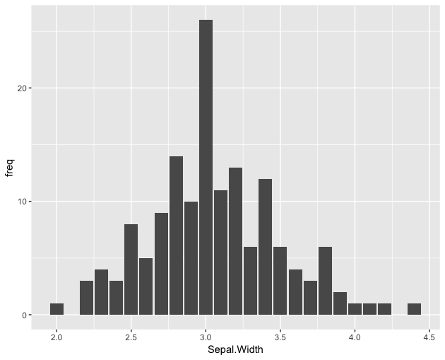
Basic plots
#Make a new count to plot
t3 = count(iris, c("Species", "Sepal.Width"))
ggplot(data=t3, aes(x=Sepal.Width,
y=freq))+
geom_bar(stat="identity")
Notes:
The next few slides will show you the code you need to make some basic plots. If you want to use your own data you just need to substitute the iris data for your own.
Here we are counting how many of each iris species has each sepal width and storing the results in a variable ‘t3’. We then use this information to build a plot!
Here we are just using the basic ggplot package, but if you want to experiment with ggplot2 there is a lot more you can do!
We are telling it that we want to make a plot using ggplot, the data ‘t3’, the X axis will be the different Sepal widths and the Y axis will be the number of times each one occurs (or the frequency) that was generated when we counted the data in the previous step. We then tell it we want a bar chart by writing geom_bar, and we want to use the values as they appear within t3 (and not modified statistically in any way) by typing stat=“identity”.

Slide 42
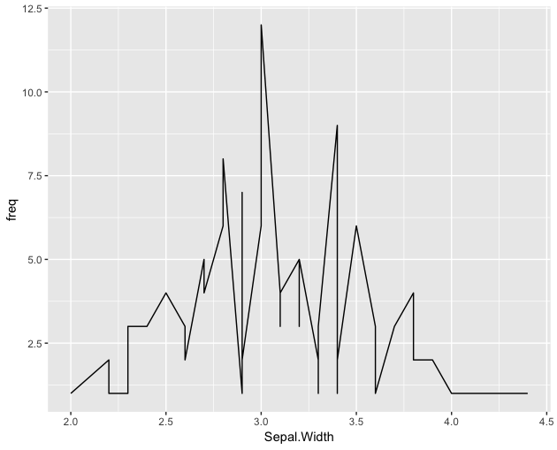
Basic plots
#Make a new count to plot
t3 = count(iris, c("Species", "Sepal.Width"))
ggplot(data=t3, aes(x=Sepal.Width,
y=freq))+
geom_line(stat="identity")
Notes:
Here we are doing exactly the same as in the previous slide, but instead of geom_bar to get a bar chart, we have written geom_line so the resulting plot will be a line graph.

Slide 43
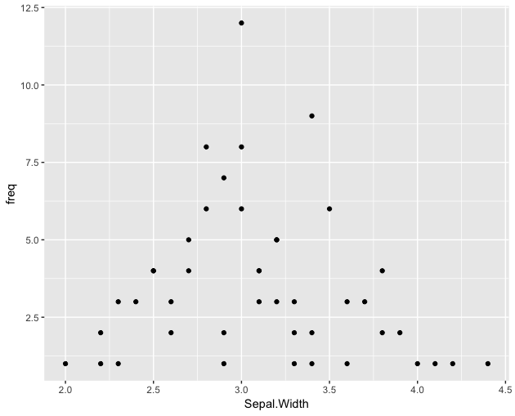
Basic plots
#Make a new count to plot
t3 = count(iris, c("Species", "Sepal.Width"))
ggplot(data=t3, aes(x=Sepal.Width,
y=freq))+
geom_point(stat="identity")
Notes:
Once again, this is exactly the same as the last two plots but instead we have written geom_point to give us a point, or scatter plot!

Slide 44
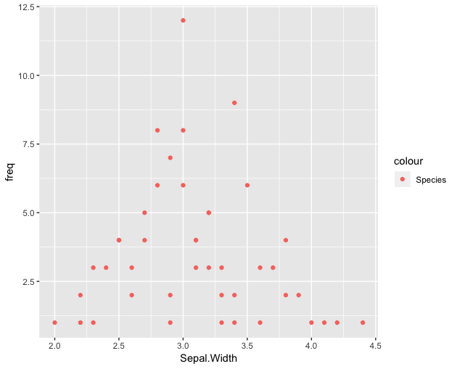
Changing colours
ggplot(data=t3, aes(x=Sepal.Width, y=freq, col="red"))+
geom_point(stat="identity")
Notes:
Now that we know how to make the three most common plot types we can modify them a little.
Here we have added the col= instruction after telling it which data to use. This quite simply tells it that rather than the automatic colour that R normally chooses, we want it to use a colour of our choice – in this case red. There are lots of different colours to choose from, the best way to find out what the options are is to search for images of “ggplot colours” online.

Slide 45
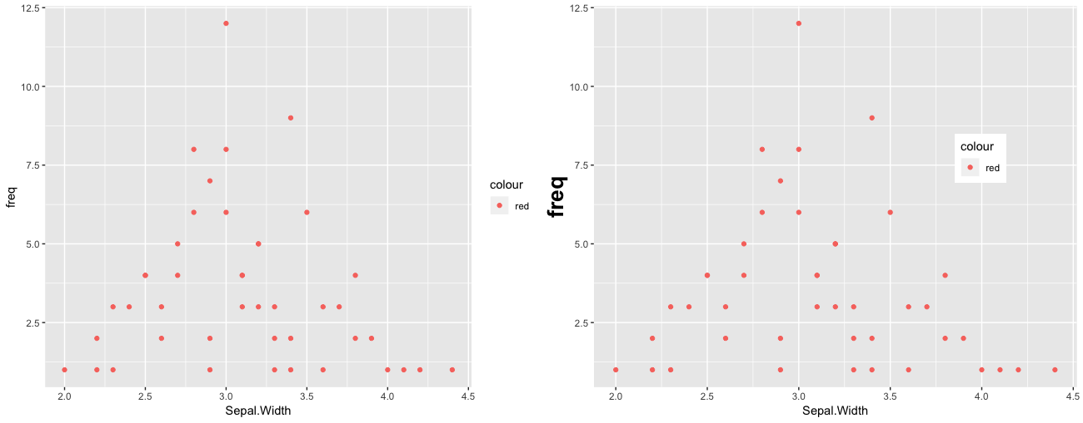
More things you can do
Shifting legends
Changing text size
Grouping plots
Notes:
Now that you have the basics down it only takes a word or two to start personalising your plots.

Slide 46
More things you can do
Shifting legends
Changing text size
Grouping plots
Notes:
Here we have changed the size of the axis title, and the location of the legend (you can find the code for this in the pegs r code file that came with this powerpoint file). We have also grouped two plots together side by side so they can be called together as one image.

Slide 47
More complexity
Notes:
There is a lot more that you can do once you have learned the basics in R.
Here I made a stacked bar plot, with a second plot as an inset. This is a little fiddly to do, but the internet is full of other people’s code that you can follow and modify to make this sort of thing.

Slide 48
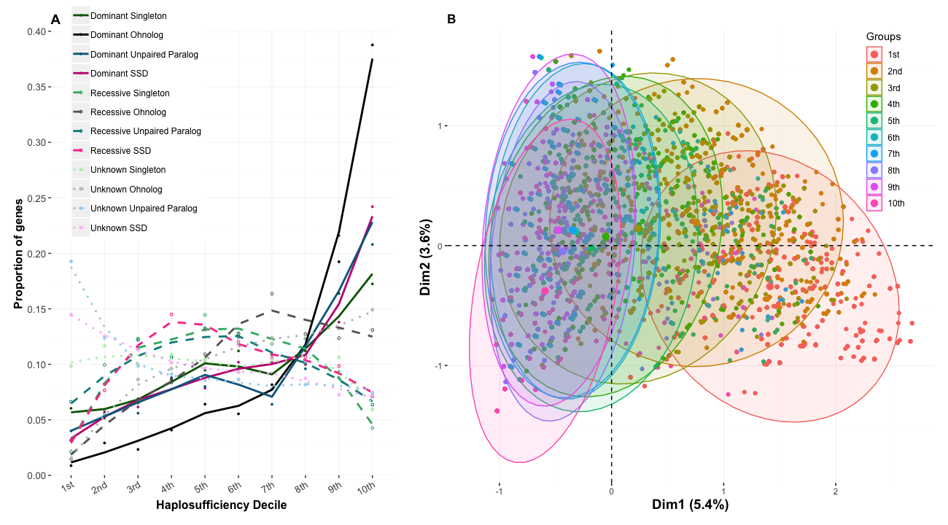
More complexity
PCA/MCA
Notes:
Here I have made a ‘grouped’ plot. The first is a line graph where I have told it to use different line types and colours for each of the variables. The second is an ‘MCA’ or Multiple correspondence analysis plot, both the plot and the data crunching was all done in R.

Slide 49
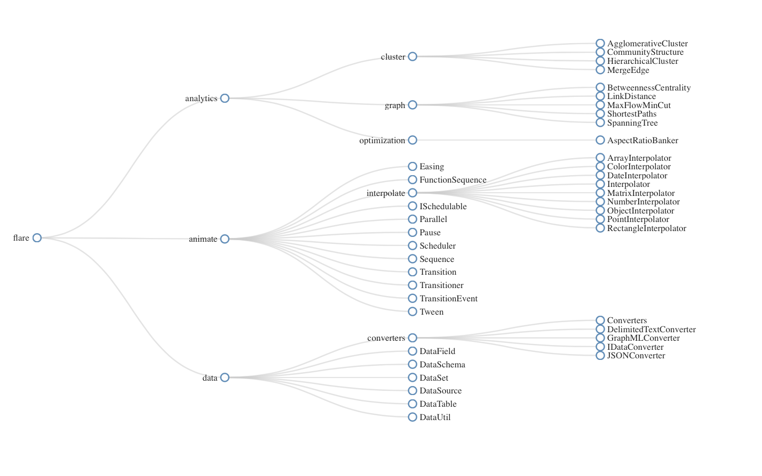
More complexity
Network D3
https://christophergandrud.github.io/networkD3/
Notes:
This isn’t one of mine, but is a lovely example of one of the things you can do using the network D3 package. There are lots of tutorials and examples of the ways different people have made plots using this package available online. It is not an especially simple package to use, but once you feel confident in your R abilities it can be used to make some of the most impressive figures!

Slide 50
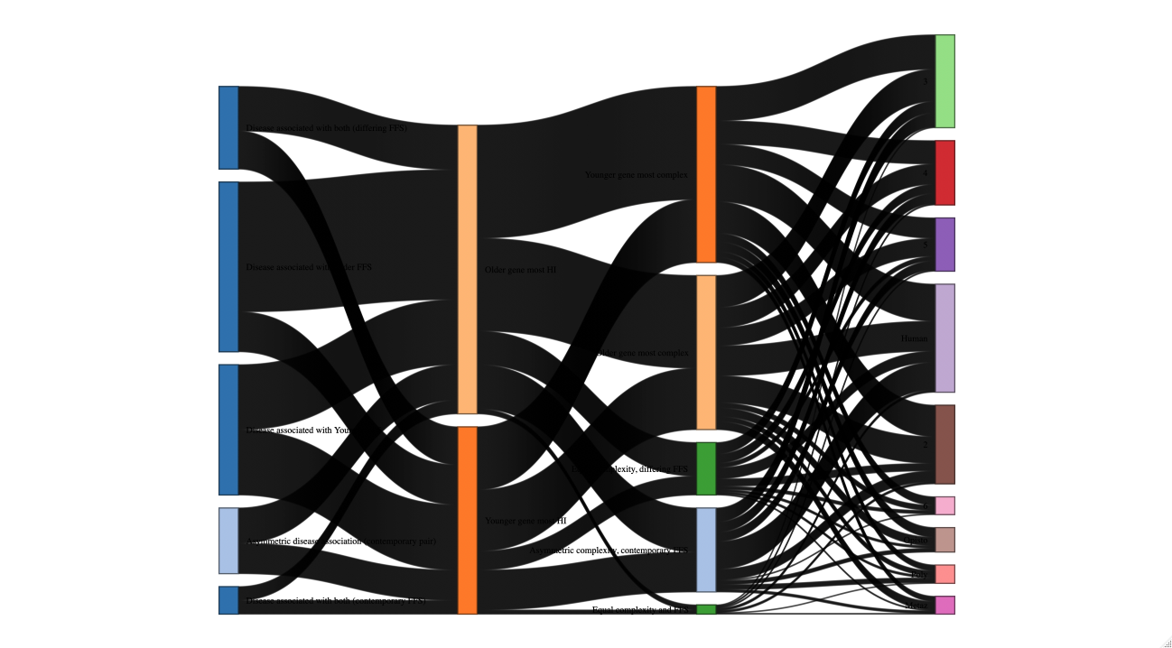
More complexity
Network D3 Sankey/River plots
Notes:
These plots are great to visualise the different subdivisions in your data. Here I made a plot to look at the different types of genes in the genome. There are more than 50k entries shown in this plot!

Slide 51
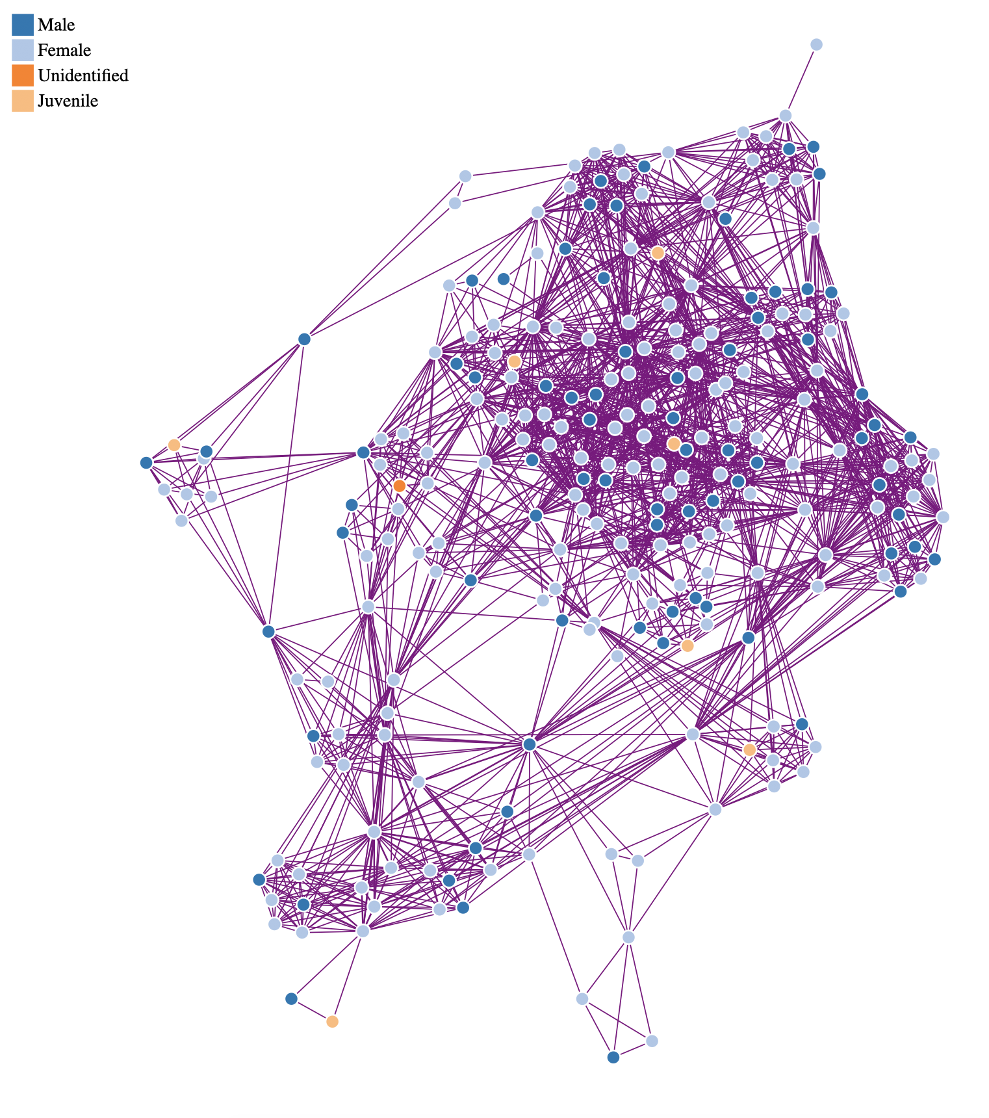
More complexity
Network D3 Interactive networks
Notes:
This is one of my favorite types of plot you can make with Network D3 – an interactive network diagram. In this example the different coloured dots (nodes) represent males, females and juveniles, and I changed the colours of the lines (edges) to purple, because I like purple!

Slide 52
A brief intro to R
What we have covered today:
1 – Basic Data analysis (Counts and averages)
2 – Simple Graphics (Bars, scatters and lines)
3 – More complexity (Cluster Plots, PCA, NetworkD3)
4 – Stats with R (prop.test())

Slide 53

Where you can get more information
A Bioinformatician’s best friend!
The ‘Statistics using R’ book (from the library)
http://www.r-tutor.com/r-introduction
https://www.r-graph-gallery.com
https://towardsdatascience.com/using-networkd3-in-r-to-create-simple-and-clear-sankey-diagrams-48f8ba8a4ace
https://www.jessesadler.com/post/network-analysis-with-r/
https://www.statmethods.net (Quick R)
Fundamentals of Data Visualisation by Claus Wilke

Slide 54
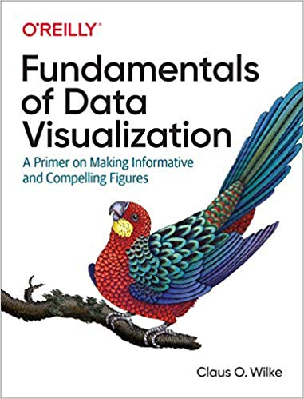

Slide 55
Thank You!
We would like to say a big thank you to the Division of Evolution and Genomic Science for supporting this series, and all of you for attending!
Please join us for drinks and chat in the café!

Slide 56

Thank you Hadley Wickham!
‪@hadleywickham‬

